Slide 1
Spinal Nerves and Autonomic Nervous System
Day 7

Slide 2
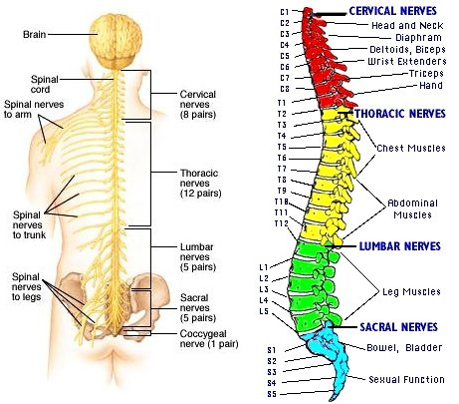

Slide 3
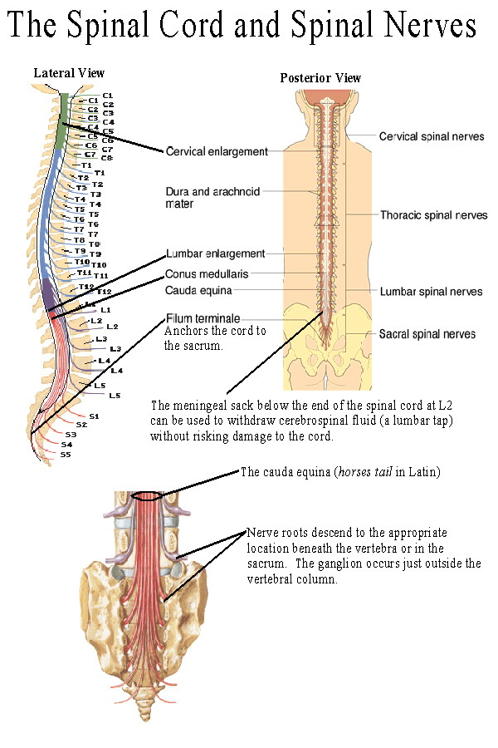
Spinal Nerves
31 Pairs
Mixed nerves that provide 2-way communication between spinal cord and limbs, neck, and trunk
Named individually, grouped according to level which they arise.

Slide 4
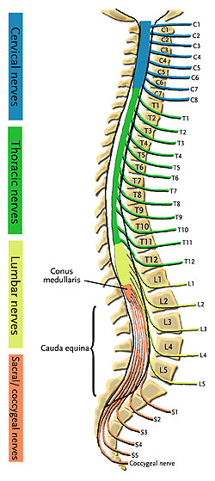
Spinal Nerves
Cervical Nerves
8 pairs (C1-C8)
Thoracic Nerves
12 pairs (T1-T12)
Lumbar Nerves
5 pairs (L1-L5)
Sacral Nerves
5 pairs (S1-S5)
Coccygeal Nerves
1 pair (Co)

Slide 5
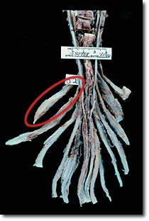
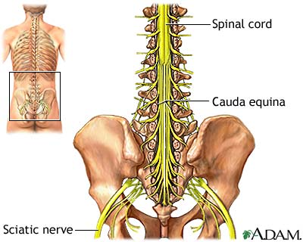
Spinal Nerves
Spinal Cord ends between 1st and 2nd lumbar vertebra
Nerves below that descend beyond cord forming structure ‘cauda equina’ (horse’s tail)
Each nerve emerges from cord by 2 roots

Slide 6
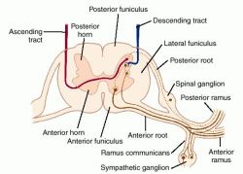
Roots
Dorsal Root
Posterior, sensory, enlargement called dorsal root ganglion identifies it, takes in sensory impulses and transmits on to spinal cord
Ventral Root
Anterior, Motor, Takes in motor impulses and moves to spinal cord
Dorsal and Ventral unite to form spinal nerve

Slide 7
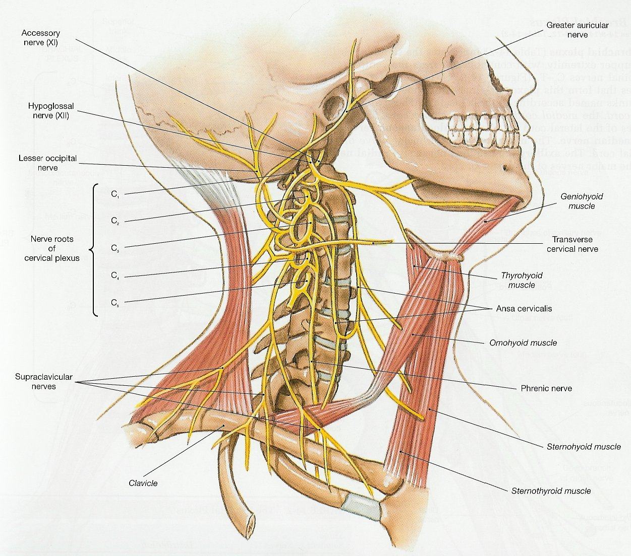
Plexuses
Complex networks of nerves
Cervical Plexuses
Lie deep in neck
Branches (C1-C4)
C1-C4 supply muscles and skin of neck
C3-C5 pass to R and L phrenic nerves which conduct motor impulses to diaphragm.

Slide 8
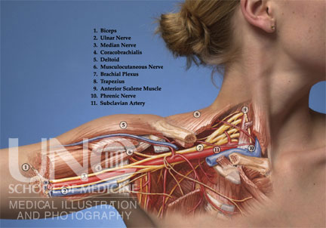
Plexuses
Brachial Plexuses
C5-C8 and T1
Supply muscles and skin of arm, forearm, and hand
Includes:
Musculocutaneous, ulnar, median, radial,and axilary nerves

Slide 9
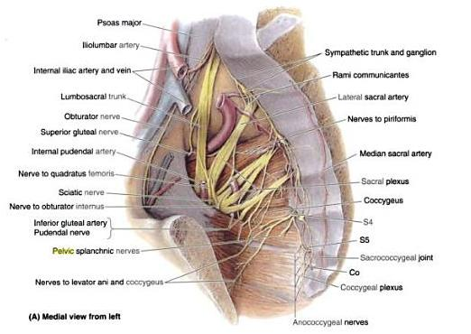
Lumbrosacral Plexuses
T12, L1-L5, S1-S5, and Co
Lumbar region into pelvic region
Give rise to # of motor and sensory fibers associated with muscles and skin of lower Ab. Wall, external genitalia, buttocks, thighs, legs, and feet.
Major Branches:
Obturator, femoral, and
sciatic nerves

Slide 10
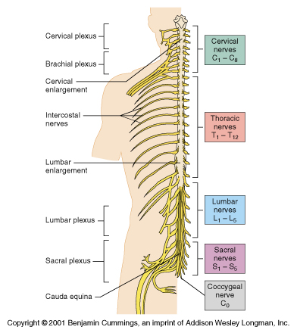
Spinal Nerves Cont.
Anterior branches of thoracic nerves enter spaces between ribs and become intercostal nerves.
Supply motor impulses into intercostal muscles and upper ab. wall
Receive impulses (sensory) from skin of thorax and abdomen

Slide 11
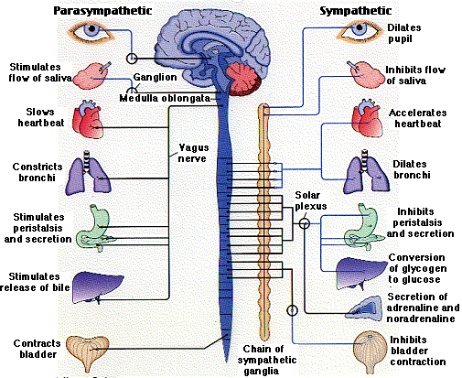
Autonomic Nervous System
Functions independently and continuously without conscious effort.
Controls visceral activities that aide in maintaining homeostasis.
Responds to emotional stress
Prepares body for strenuous physical activity.

Slide 12
General Characteristics of ANS
Sensory impulses enter brain or spinal cord
Motor impulses travel out and into the PNS through cranial and spinal nerves
2 Divisions
Sympathetic
Prepares body for energy expending, stressful or emergency situations
Parasympathetic
Most active under ordinary, restful conditions
Restores body back to resting state following stressful experiences.

Slide 13
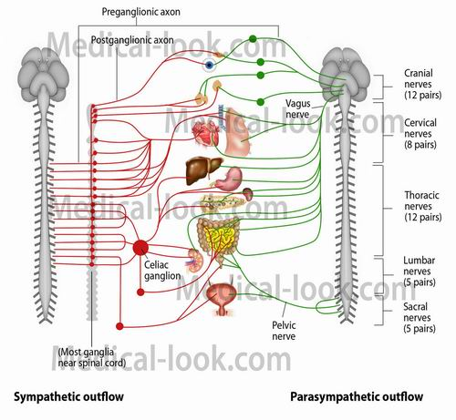

Slide 14
Autonomic Nerve Fibers
Motor Fibers
Sympathetic Division
Preganglionic fibers originate from neurons in the gray matter of spinal cord
Parasympathetic Division
Preganglionic fibers arise from brain stem and sacral region

Slide 15
Autonomic Neurotransmitters
Preganglionic fibers secrete acetylcholine called cholinergic fibers
Most parasynpathetic fibers secrete acetylcholine but sympathetic secretes norepinephrine and are called adrenergic fibers

Slide 16
Review
How are spinal nerves grouped?
Name and locate the major nerve plexuses.
What parts of the nervous system are included in the autonomic nervous system?
How are the divisions of the autonomic nervous system distinguished?

